Slide 1


Figures for Metis documentation

Slide 2
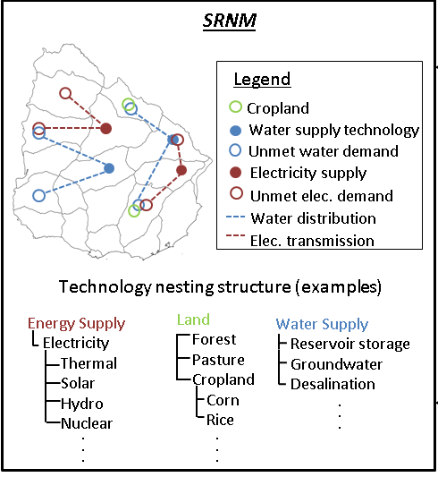
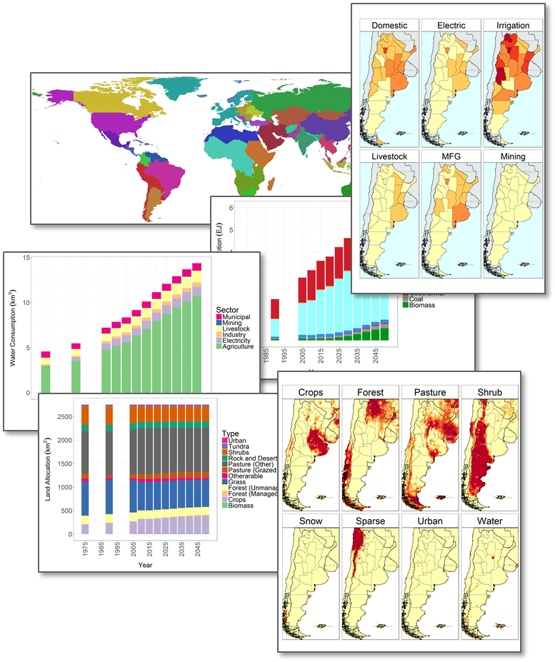
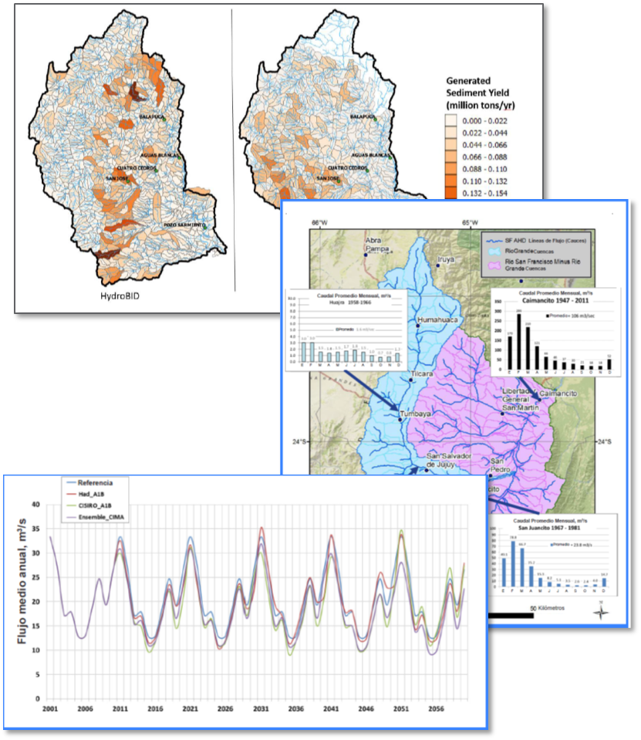
Integrated Assessment Modeling Ecosystems
(e.g., GCAM)
Aggregated Regional Nexus Model
(Metis)
High-Fidelity Sectoral Models
(e.g., HydroBID)
Metis

Slide 3
Global Multi-Sector Dynamic Models
(e.g., GCAM)
Aggregated Regional Nexus Model
(Metis)
High-Fidelity Sectoral Models
(e.g., HydroBID)
Metis

Slide 4
Metis 1.0
Metis 2.0
Metis 3.0
Metis x
Visualize
Link
Build
…
Charts
Links – I/O
Infrastructure
Maps
Calibration
Transfers
Spatial Aggregation
Forecasting

Slide 5
Modules
Key Functions
Descriptions
metis.io.R
Analyze inter-sectoral links in Input/Output Tables
Produce Sankey diagrams showing inter-sectoral flows
Produce A matrices showing inter-sectoral intensities.
IO
metis.chartsProcess.R
metis.chart.R
Create charts for each region, scenario
Create diff-plots to compare scenarios
Create combined plots to compare regions
Charts
metis.boundaries
metis.mapsProcess.R
metis.map.R
Create maps showing regional and sub-regional boundaries
Create raster and polygon maps to show parameters
Create diff-maps to compare scenarios
Maps
Spatial Aggregation
metis.grid2poly
metis.gridByPoly
Aggregate gridded data to given boundary shapefile
Overlay grid cells over region boundaries
Get table with lat, lon and which sub-region they lie in
metis.readgcam.R
metis.prepGrid.R
Read GCAM data
Create tables for selected parameters in appropriate format
Create templates for stakeholder local data
Data Prep

Slide 6
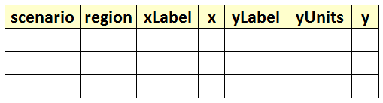
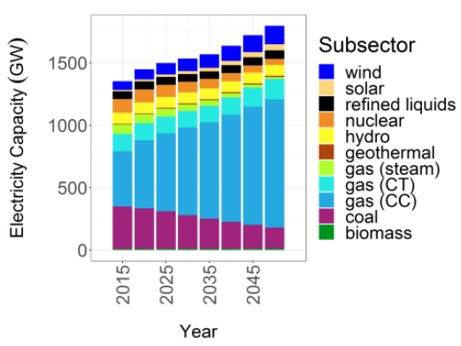
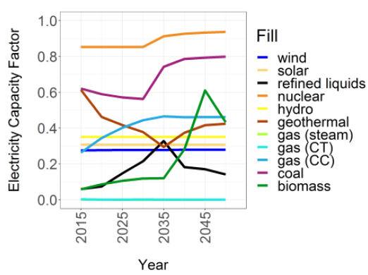
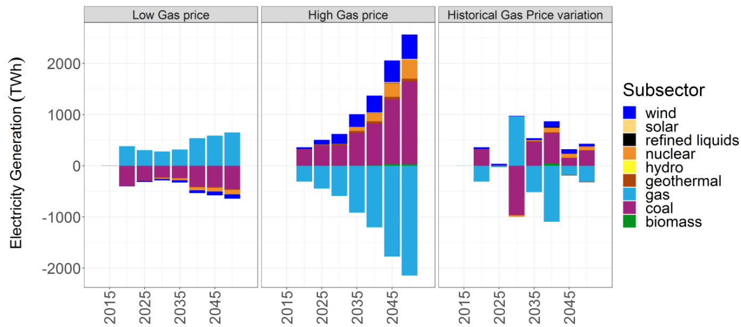
Standardized Tables
1. Default Values
2. Blank Template for users
GCAM database
Query File
metis.readgcam.R
Any Standardized Table
Charts
metis.chartsProcess.R
metis.chart.R

Slide 7
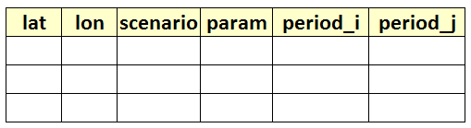
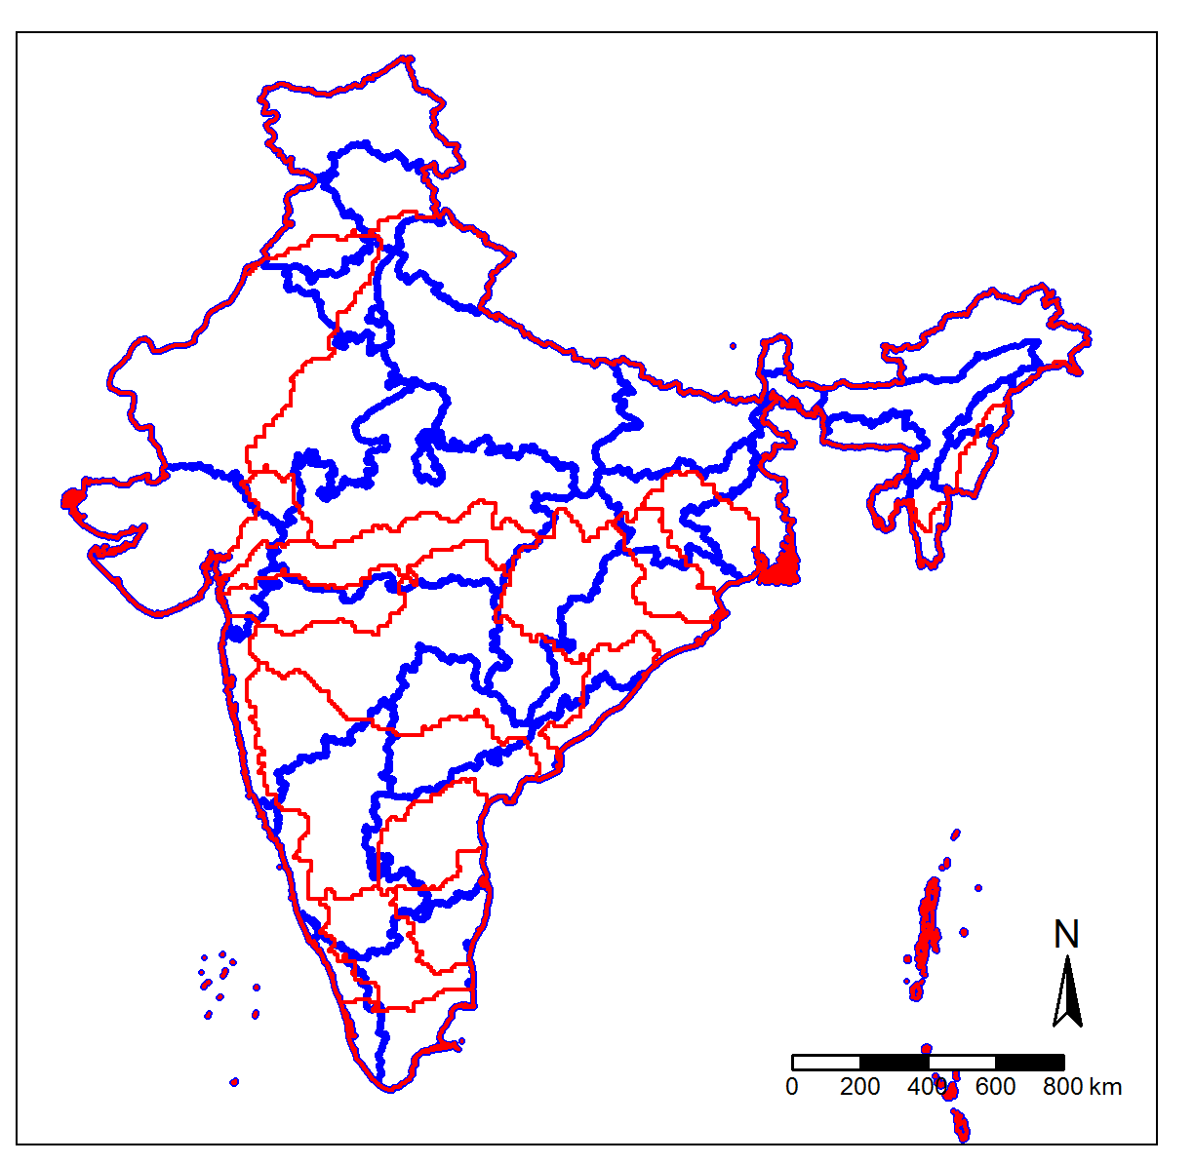
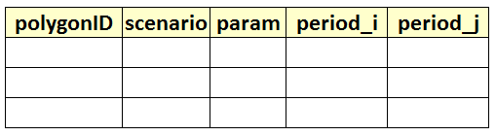
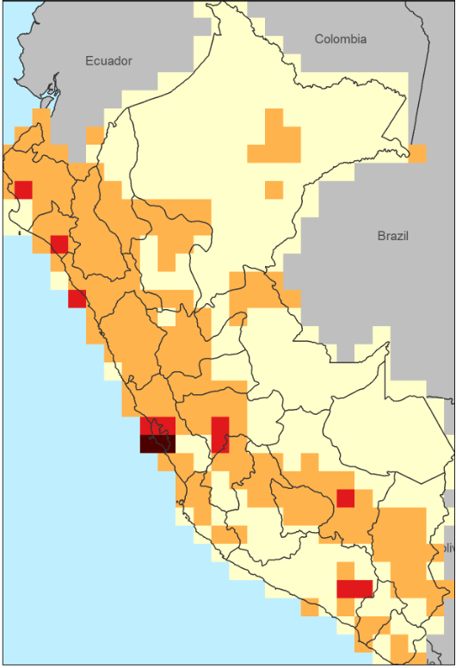
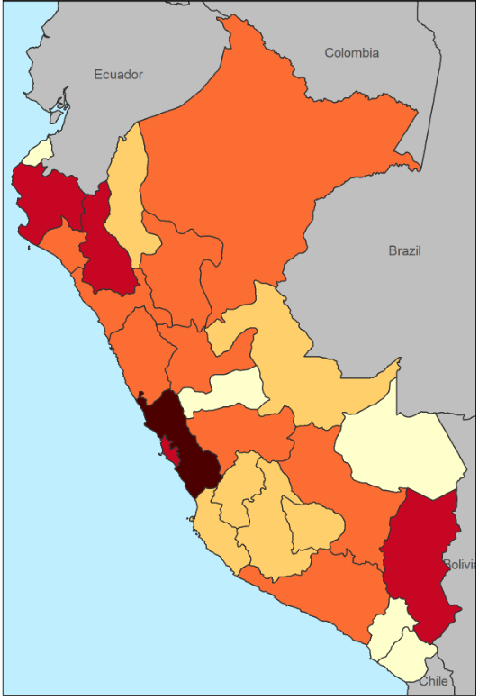
Standardized Grid Tables
1. Default Values
2. Blank Template for users
Raw gridded data
metis.prepGrid.R
Any Standardized Grid Table
Any Shapefile
Standardized Polygon Tables
metis.boundaries.R metis.grid2poly.R
1. Default Values
2. Blank Template for users
Any Standardized Polygon Table
Polygon Shapefile
Maps
1. Gridded
2. Polygons
metis.mapsProcess.R
metis.maps.R

Slide 8
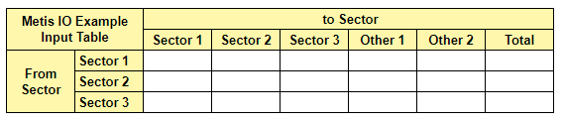
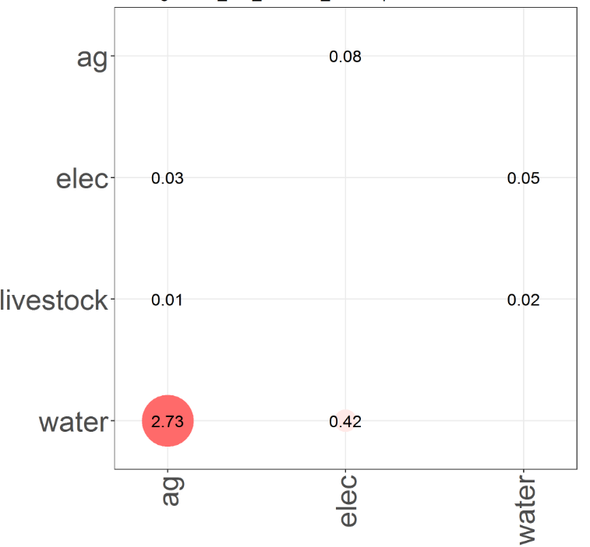
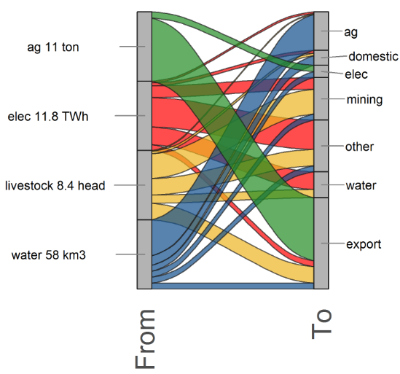
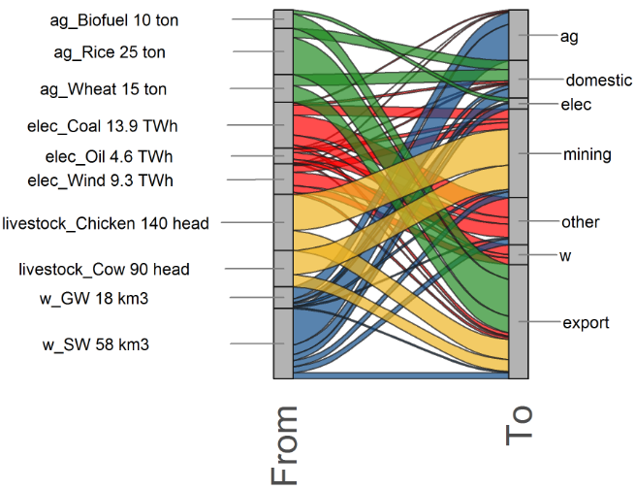
Standardized IO Tables
Metis regional + sub-regional analysis
Local Expert data
Local fine-scaled models
1. Default Values
2. Blank Template for users
Any Standardized IO Table
metis.io.R
IO Outputs
Intensity matrix
Sankey by sector
Sankey by sub-sector

Slide 9
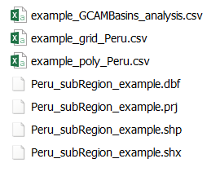
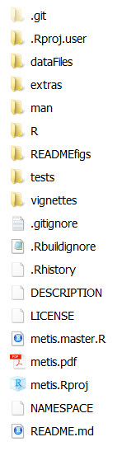
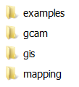
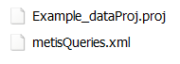
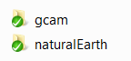
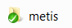
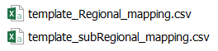
Notes:
Installation Guide

Slide 10
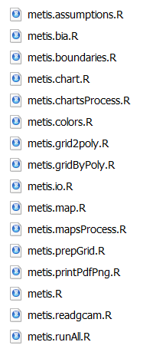

Slide 11
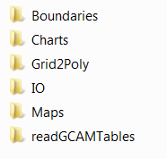

Slide 12
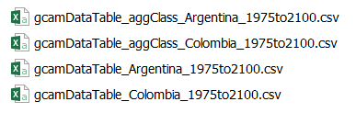
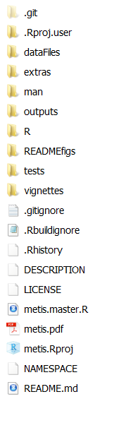
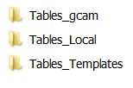
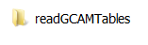
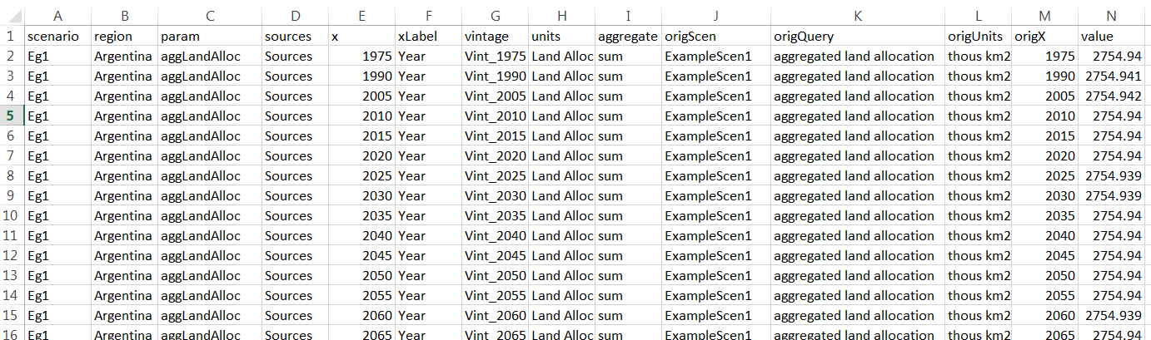
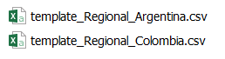
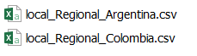
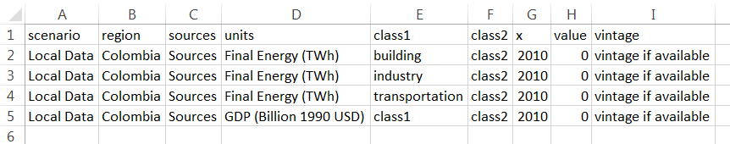
Not created automatically. Need to Add this file after getting data from local stakeholders
Notes:
Installation Guide

Slide 13
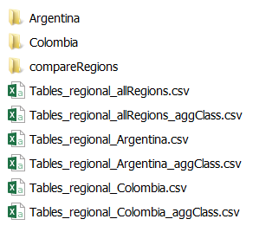
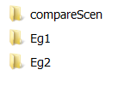
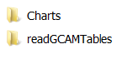
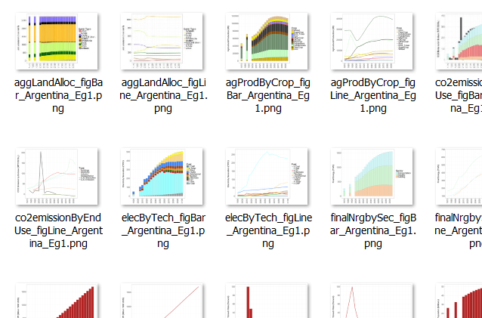
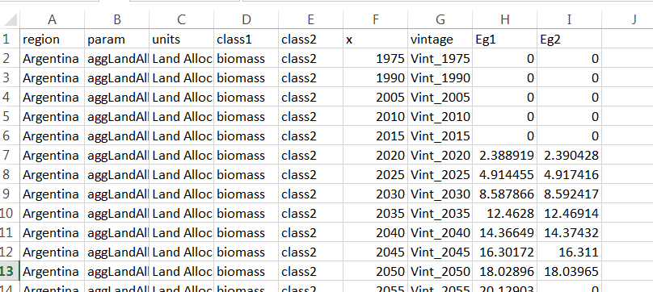
All figures are based on data from these tables
Notes:
Installation Guide

Slide 14
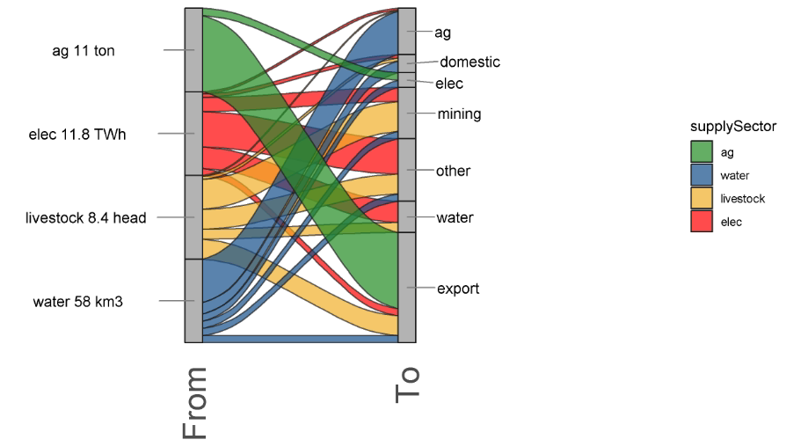
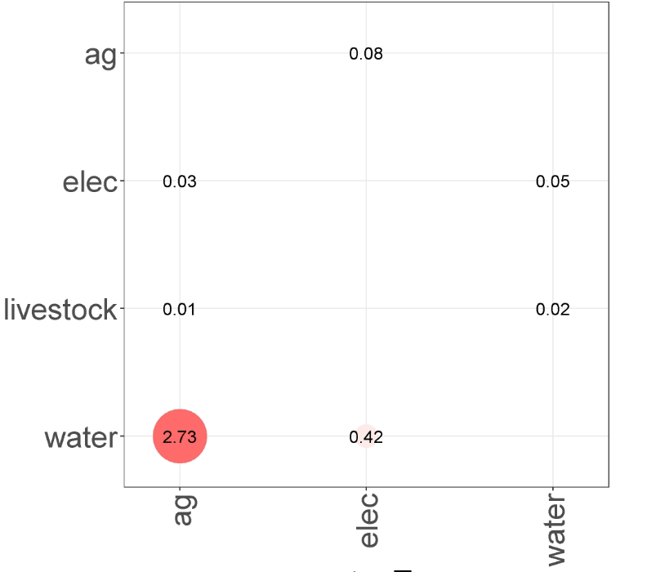
(a)
(b)

Slide 15
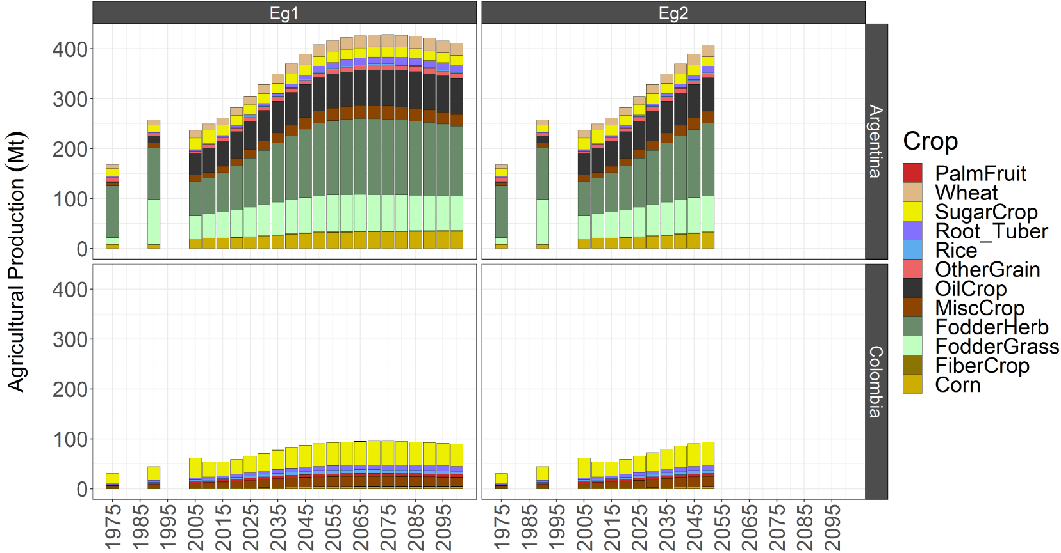
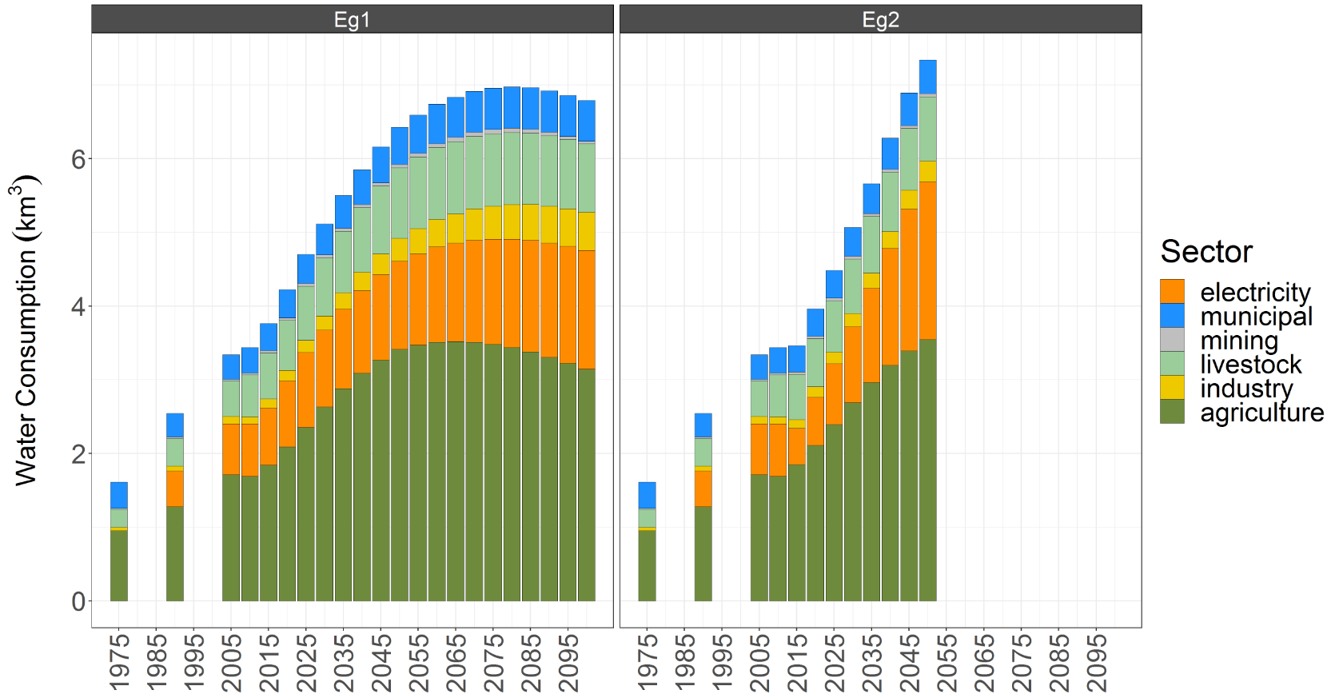
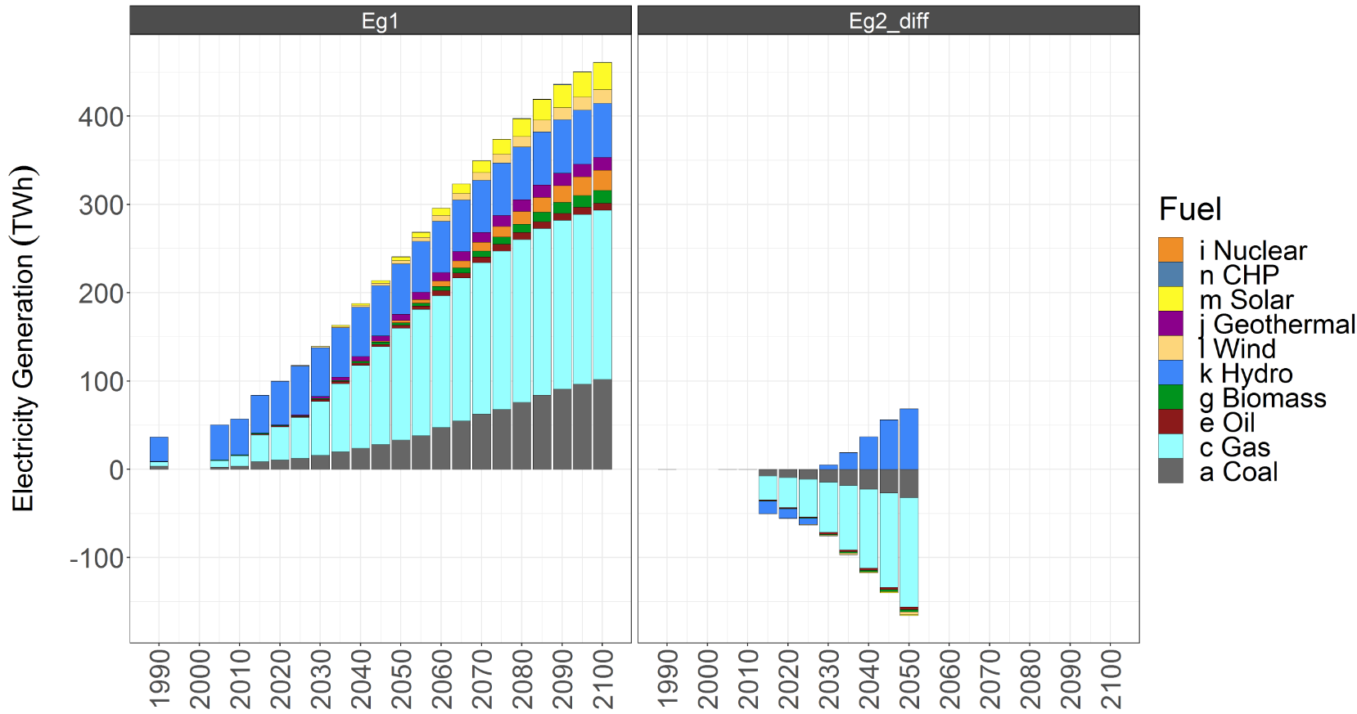
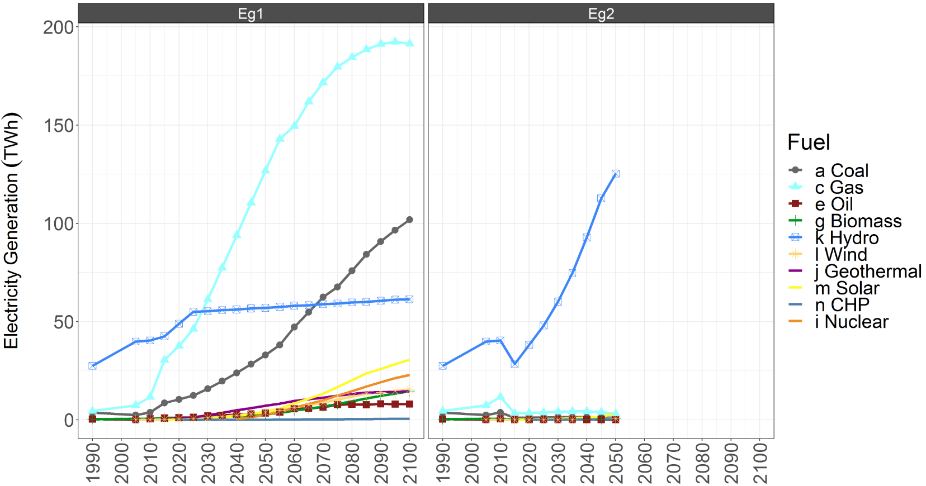
Compare Regions & scenarios
Compare Scenarios
Diff Charts
Line Charts
Notes:
Installation Guide

Slide 16
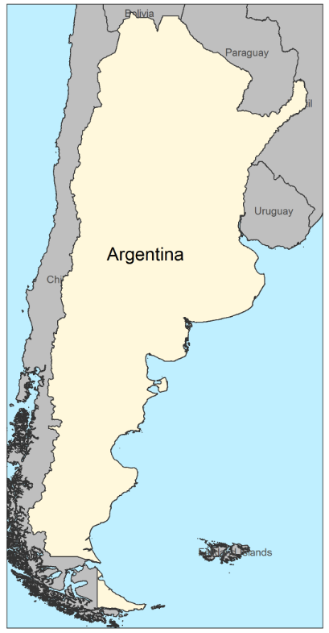
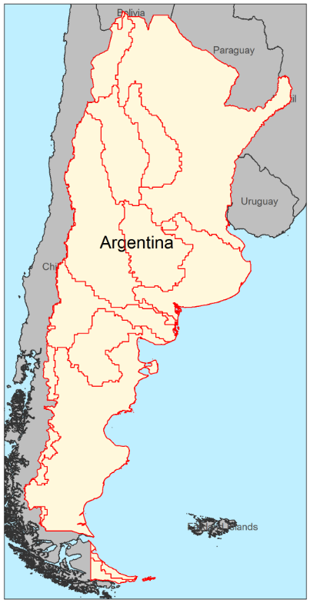
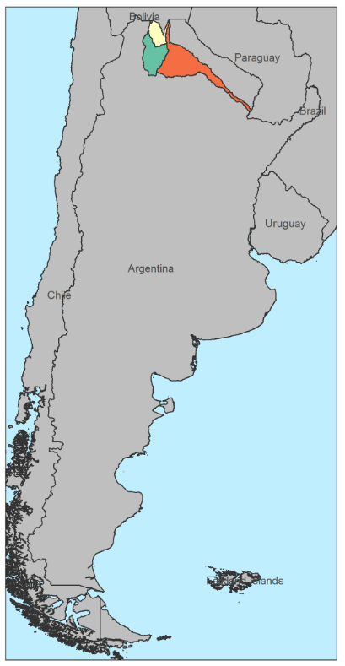
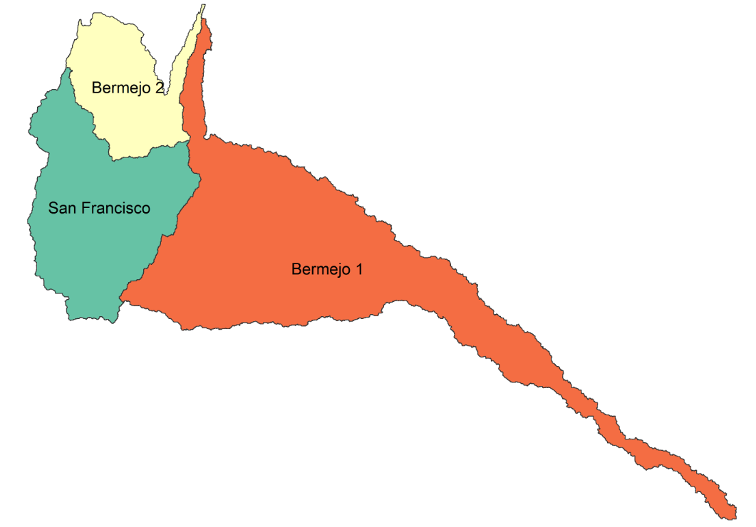
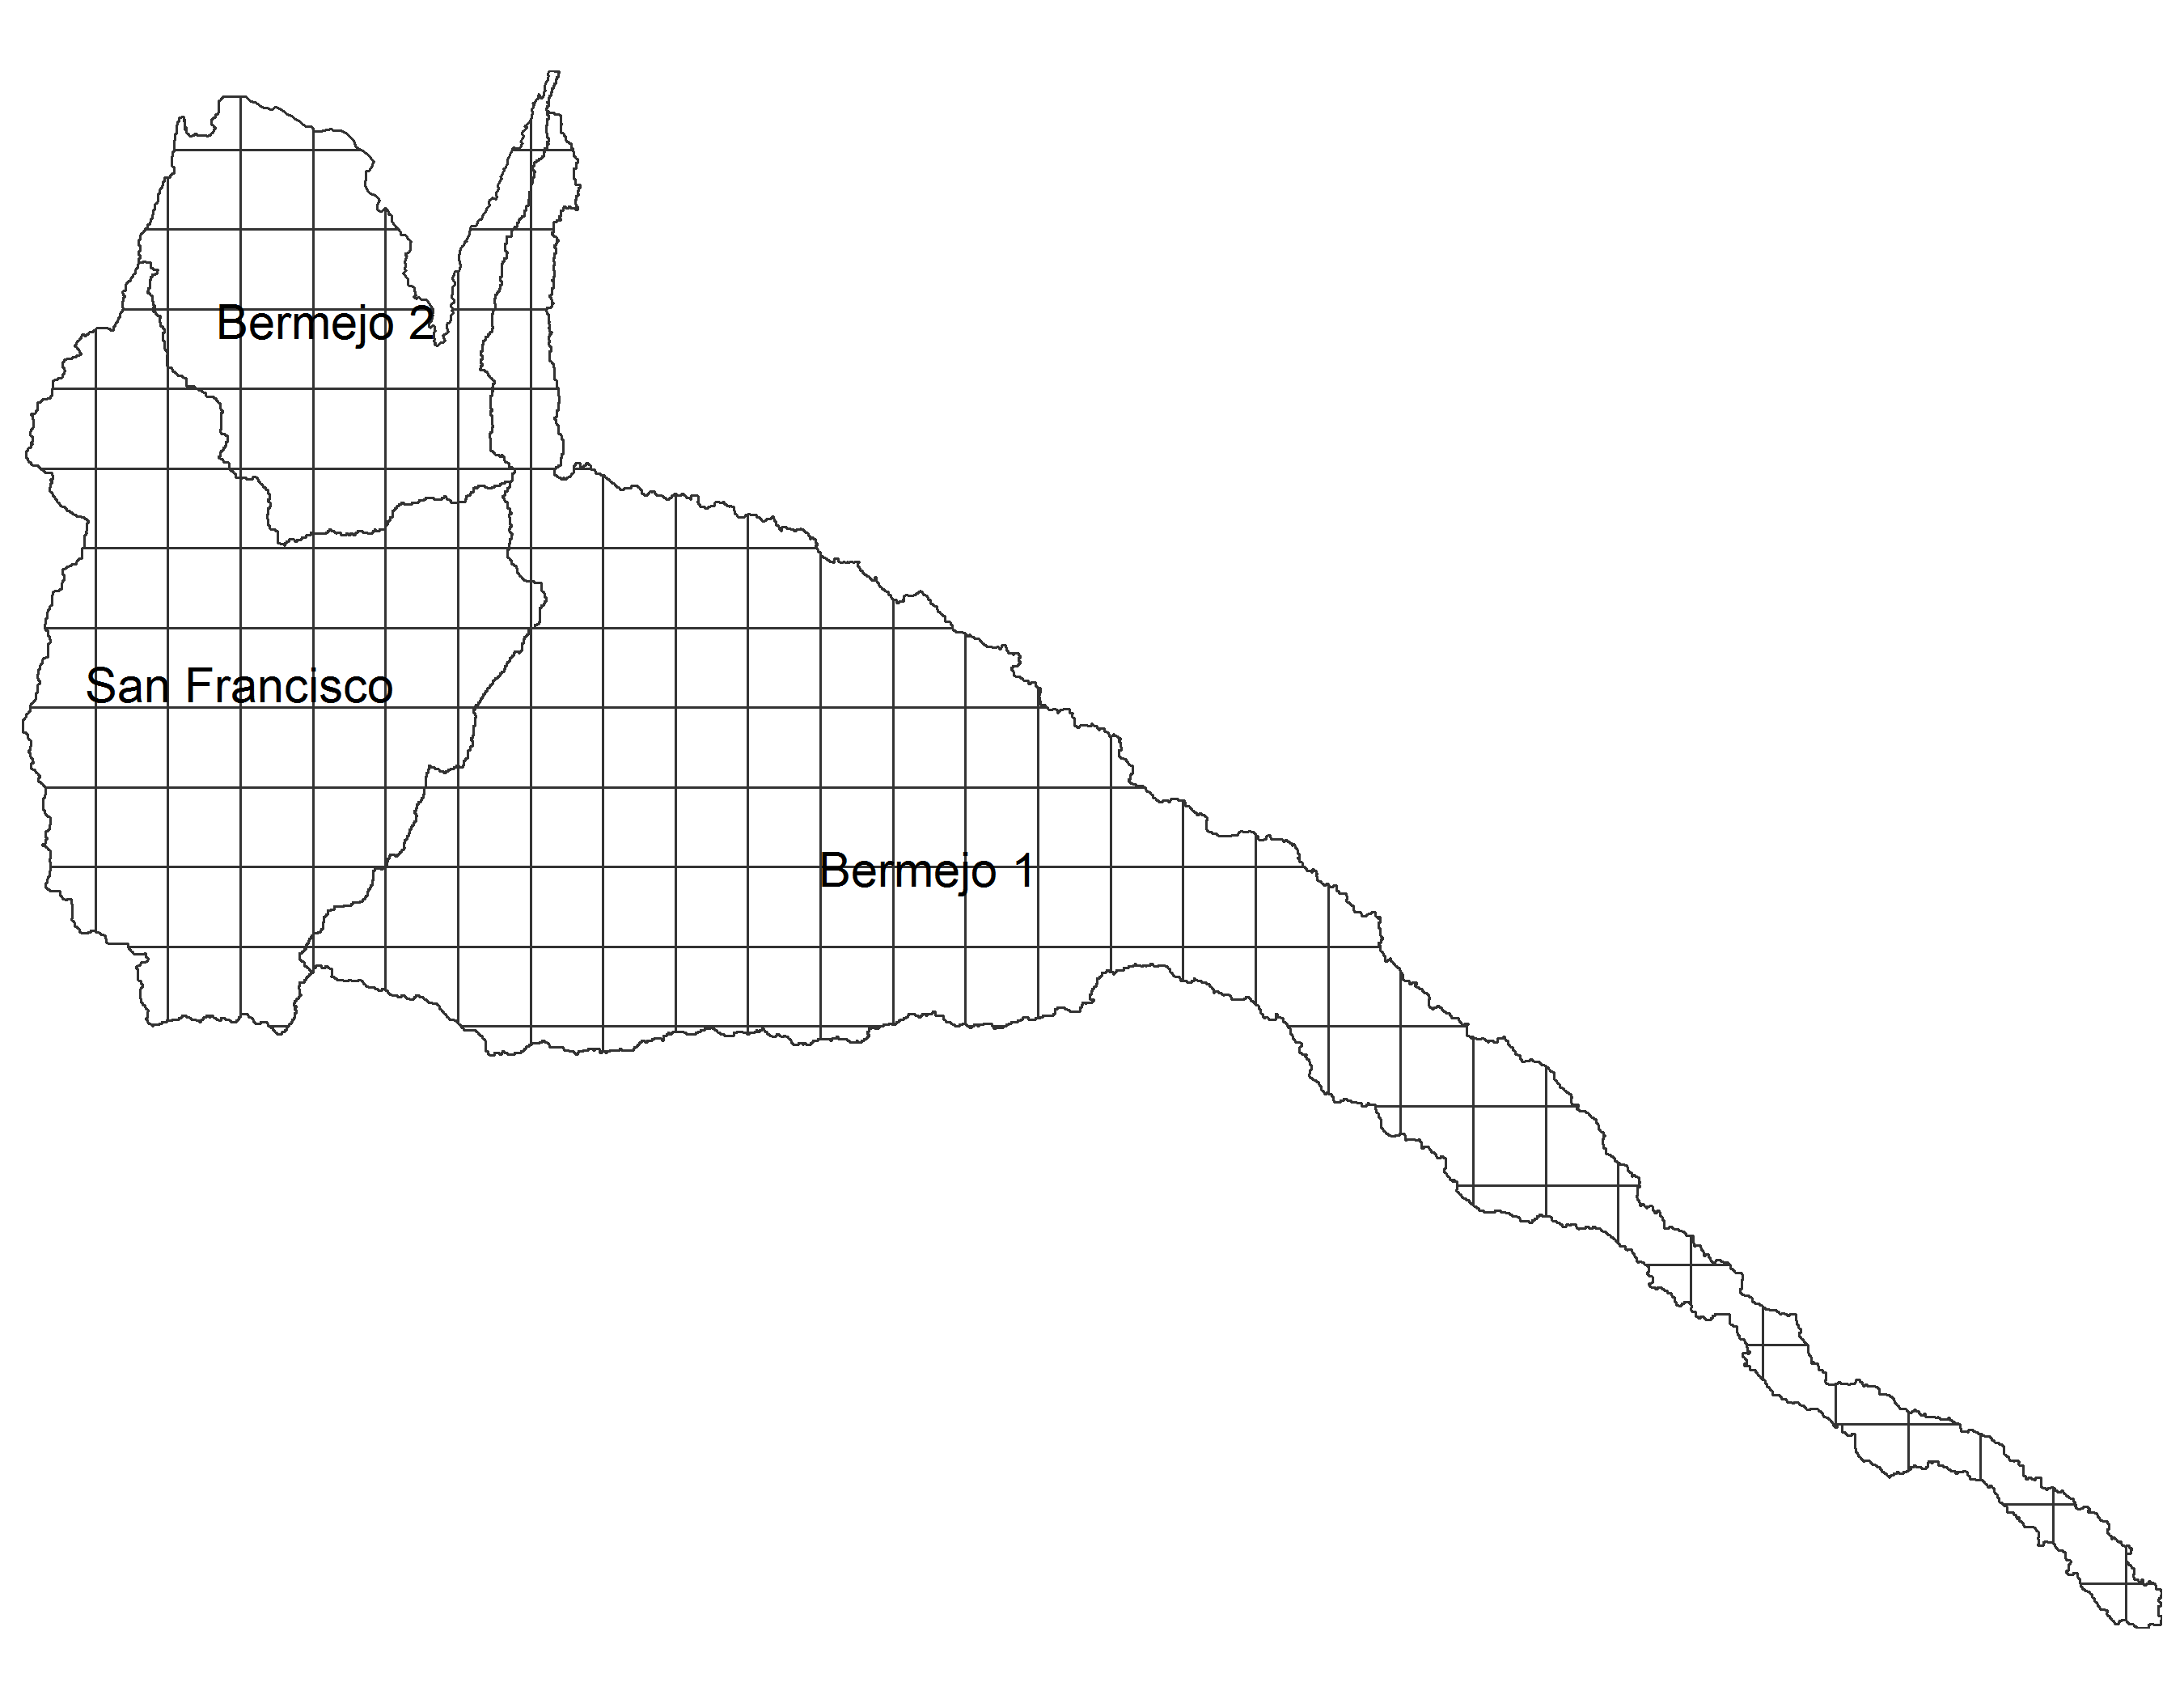
Regional highlight
Overlap Lines
Sub-regions Extended
Sub-regions Close-up
Sub-regions vs Grid Size

Slide 17
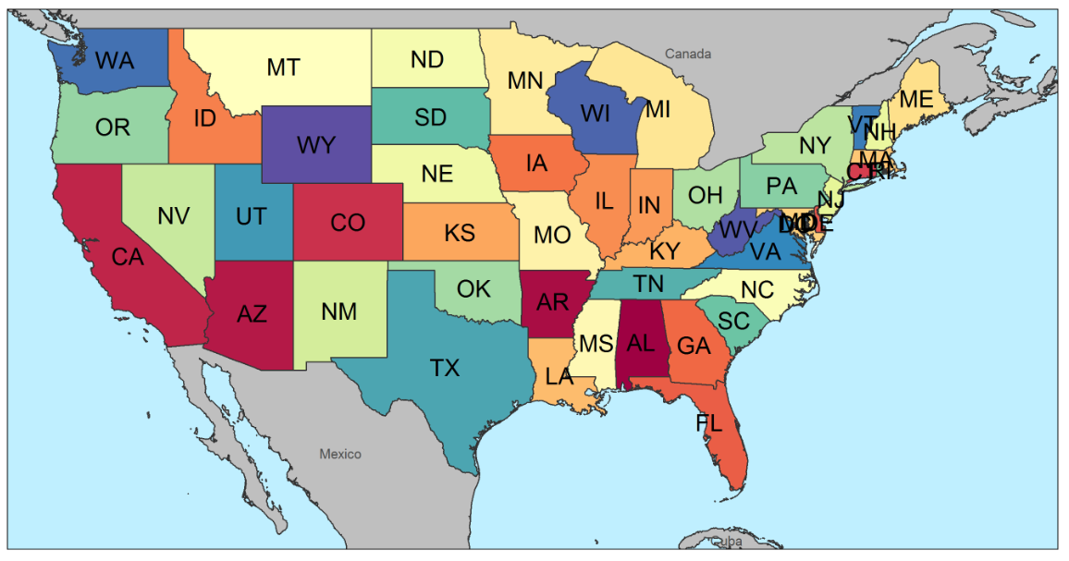



Polygons
Sub-set Regions
Visualize Overlapped Shapes and Grids

Slide 18



Gridded Data by Year
Polygon Data by Sub-Sector
Polygon Data by Year

Slide 19
Example
Grid Cell
Values
Raster Area
Weights
Polygon Area
Weights
90%
10%
1000
60%
50%
50%
100
30%
20%
80%
10
10%
For Vol (e.g. m³) – Sum of Raster Area Weighted
For Depth (e.g. mm) – Mean of Polygon Area Weighted
1000 x 0.9
1000 x 0.6
100 x 0.5
100 x 0.3
10 x 0.2
10 x 0.1
Sum = 900+50+2 = 952 m³
Mean = (600+30+1)/3 = 631/3 = 210.33 mm

Slide 20







Slide 21






Slide 22



Free Scale
kmeans
Equal breaks

Slide 23











Metis IO – Basic Theory
Matrix Rows Sums - $i$
$i$ = $\left[\begin{aligned}1 \\ 1 \\ 1\end{aligned}\right]$
$Z$ = $\left[\begin{matrix}0 & 15 & 5 \\ 10 & 0 & 200 \\ 5 & 0 & 0\end{matrix}\right]$
For each sub-region we have a Flow Matrix
$Zi$ = $\left[\begin{aligned}0+15+5 \\ 10+0+200 \\ 5+0+0\end{aligned}\right]$
= $\left[\begin{aligned}20 \\ 210 \\ 5\end{aligned}\right]$
Metis IO Table Example |  | Demand Sectors
 |  | Electricity | Water | Agriculture | Industry | Residential | Other Sectors | Total
Supply Sectors | Electricity (TWh) | - | 15 | 5 | 100 | 70 | 30 | 220
 | Water (km³) | 10 | - | 200 | 10 | 80 | 100 | 400
 | Agriculture (Mt) | 5 | - | - | 10 | 5 | 20 | 40
Nexus flows
Other flows
Total
$$Zi$$
$$+$$
$$Fi$$
$$=$$
$$x$$

Slide 24

Metis IO – Basic Theory
The water system demands 15 TWh of Electricity
To supply 400 Km³ of total water
Interconnected Nexus
Metis IO Table Example |  | Demand Sectors
 |  | Electricity | Water | Agriculture | Industry | Residential | Other Sectors | Total
Supply Sectors | Electricity (TWh) | - | 15 | 5 | 100 | 70 | 30 | 220
 | Water (km³) | 10 | - | 200 | 10 | 80 | 100 | 400
 | Agriculture (Mt) | 5 | - | - | 10 | 5 | 20 | 40
Nexus sectors are interconnected
If the demand for total water increases from 400 Km³ then:
Electricity required to supply 400 Km³ which was initially 15 TWh will also increase
To capture complete impacts need to track nexus interdependencies
Nexus flows
Other flows
Total
$Z$i
$$+$$
$$Fi$$
$$=$$
$$x$$

Slide 25










Metis IO – Basic Theory
The water system demands 15 TWh of Electricity
To supply 400 Km³ of total water
The electric intensity of the water system is said to be
15 TWh / 400 Km³ = 0.0375 TWh/Km³
Intensity matrix - $A$
$Z$ = $\left[\begin{matrix}0 & 15 & 5 \\ 10 & 0 & 200 \\ 5 & 0 & 0\end{matrix}\right]$
Metis IO Table Example |  | Demand Sectors
 |  | Electricity | Water | Agriculture | Industry | Residential | Other Sectors | Total
Supply Sectors | Electricity (TWh) | - | 15 | 5 | 100 | 70 | 30 | 220
 | Water (km³) | 10 | - | 200 | 10 | 80 | 100 | 400
 | Agriculture (Mt) | 5 | - | - | 10 | 5 | 20 | 40
$x$ = $\left[\begin{matrix}220 \\ 400 \\ 40\end{matrix}\right]$
$$\left[\begin{matrix}220 & 0 & 0 \\ 0 & 400 & 0 \\ 0 & 0 & 40\end{matrix}\right]$$
$$\hat{x}=$$
$$\left[\begin{matrix}\frac{1}{220} & 0 & 0 \\ 0 & \frac{1}{400} & 0 \\ 0 & 0 & \frac{1}{40}\end{matrix}\right]$$
$${\hat{x}}^{−1}=$$
$$\left[\begin{matrix}0 & 15 & 5 \\ 10 & 0 & 200 \\ 5 & 0 & 0\end{matrix}\right]\left[\begin{matrix}\frac{1}{220} & 0 & 0 \\ 0 & \frac{1}{400} & 0 \\ 0 & 0 & \frac{1}{40}\end{matrix}\right]$$
$A=Z{\hat{x}}^{−1}$ =
Nexus flows
Other flows
Total
$A$ = $\left[\begin{matrix}0 & 0.0375 & 0.125 \\ 0.0454 & 0 & 5 \\ 0.0227 & 0 & 0\end{matrix}\right]$
$$Zi$$
$$+$$
$$Fi$$
$$=$$
$$x$$

Slide 26















Metis IO – Basic Theory
Connecting the entire system
$$A=Z{\hat{x}}^{−1}$$
$$Z=A\hat{x}$$
$$x=A\hat{xi}+Fi$$
$$x=Ax+f$$
$$x={(I−A)}^{−1}f$$
$$x=Lf$$
Intensity matrix - $A$
( $\hat{xi}=x , Fi=f$ )
$$(I−A)x=f$$
$Z$ = $\left[\begin{matrix}0 & 15 & 5 \\ 10 & 0 & 200 \\ 5 & 0 & 0\end{matrix}\right]$
Metis IO Table Example |  | Demand Sectors
 |  | Electricity | Water | Agriculture | Industry | Residential | Other Sectors | Total
Supply Sectors | Electricity (TWh) | - | 15 | 5 | 100 | 70 | 30 | 220
 | Water (km³) | 10 | - | 200 | 10 | 80 | 100 | 400
 | Agriculture (Mt) | 5 | - | - | 10 | 5 | 20 | 40
$x$ = $\left[\begin{matrix}220 \\ 400 \\ 40\end{matrix}\right]$
$$\left[\begin{matrix}220 & 0 & 0 \\ 0 & 400 & 0 \\ 0 & 0 & 40\end{matrix}\right]$$
$$\hat{x}=$$
Nexus flows
Other flows
Total
$$\left[\begin{matrix}\frac{1}{220} & 0 & 0 \\ 0 & \frac{1}{400} & 0 \\ 0 & 0 & \frac{1}{40}\end{matrix}\right]$$
$$Zi$$
$$+$$
$$Fi$$
$$=$$
$$x$$
$${\hat{x}}^{−1}=$$
Intensity Matrix
Leontief Inverse
$$\left[\begin{matrix}0 & 15 & 5 \\ 10 & 0 & 200 \\ 5 & 0 & 0\end{matrix}\right]\left[\begin{matrix}\frac{1}{220} & 0 & 0 \\ 0 & \frac{1}{400} & 0 \\ 0 & 0 & \frac{1}{40}\end{matrix}\right]$$
$A=Z{\hat{x}}^{−1}$ =
$$A$$
$$L$$
Any changes in Demand, Supply or Intensity can now be tracked throughout the system
$A$ = $\left[\begin{matrix}0 & 0.0375 & 0.125 \\ 0.0454 & 0 & 5 \\ 0.0227 & 0 & 0\end{matrix}\right]$
Notes:
* From Miller, R.E. and Blair, P.D., 2009. Input-output analysis: foundations and extensions. Cambridge university press, pp 12-25.

